Slide 1
Layout basic
https://learn.microsoft.com/en-us/windows/apps/design/layout

Slide 2
Screen sizes & breakpoints

Slide 3
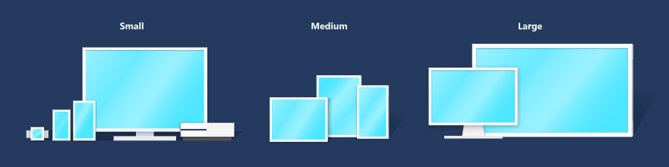
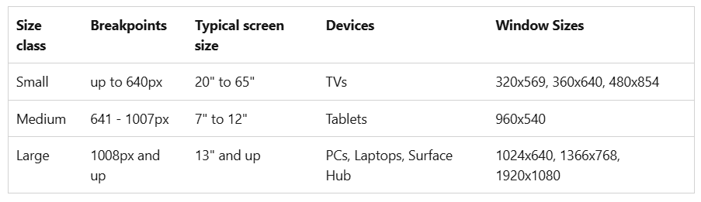
Breakpoints

Slide 4
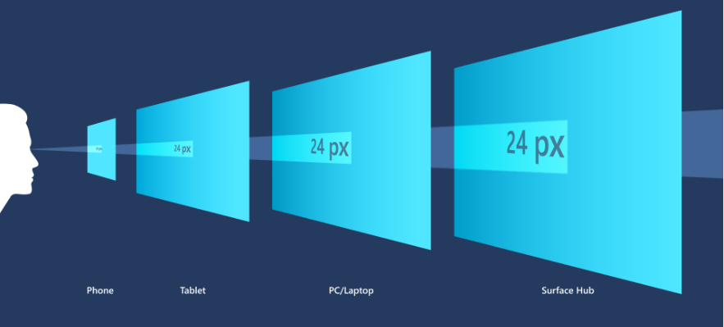
Effective pixels and scale factor
Scaling algorithm takes into account viewing distance and screen density (pixels per inch) to optimize for perceived size

Slide 5
Why are TVs considered "small"?
Viewing distance
Effective pixels
1080p TV has 1080 physical pixels
540 effective pixels
=> designing for a TV == designing for a small screen

Slide 6
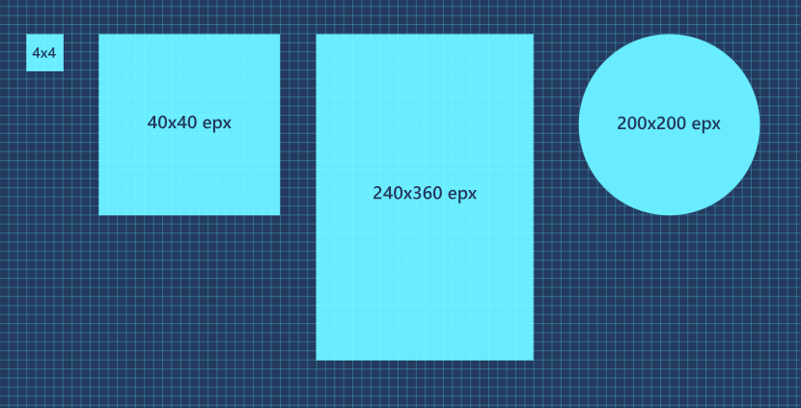
Multiples of Four
The sizes, margins, and positions of UI elements should always be in multiples of 4 epx

Slide 7
Responsive design techniques
Responsive design techniques - Windows apps | Microsoft Learn

Slide 8
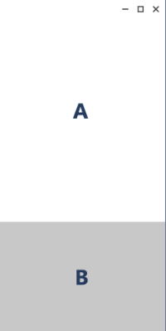
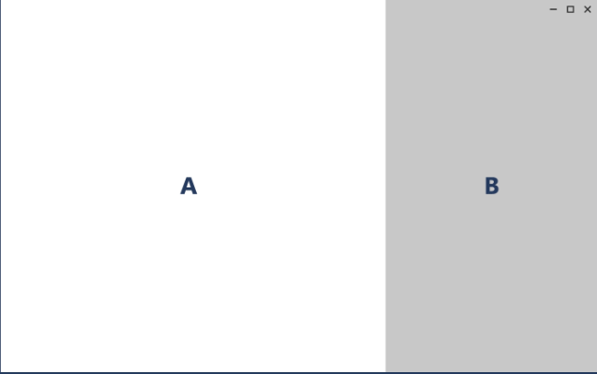
Reposition

Slide 9
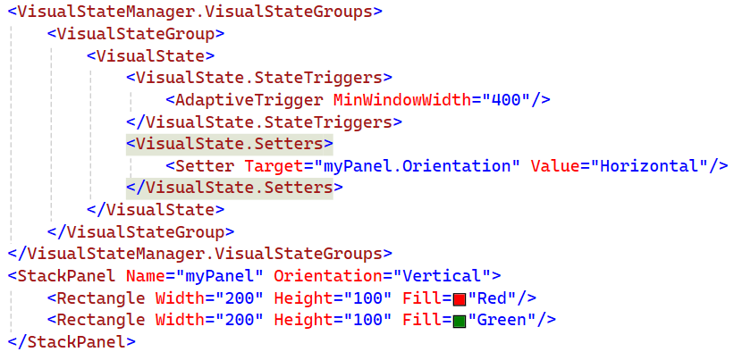
VisualState > StateTrigger (inside a Grid > Page)
Notes:
<Grid>
<VisualStateManager.VisualStateGroups>
<VisualStateGroup>
<VisualState>
<VisualState.StateTriggers>
<AdaptiveTrigger MinWindowWidth="400"/>
</VisualState.StateTriggers>
<VisualState.Setters>
<Setter Target="myPanel.Orientation" Value="Horizontal"/>
</VisualState.Setters>
</VisualState>
</VisualStateGroup>
</VisualStateManager.VisualStateGroups>
<StackPanel Name="myPanel" Orientation="Vertical">
<Rectangle Width="200" Height="100" Fill="Red"/>
<Rectangle Width="200" Height="100" Fill="Green"/>
</StackPanel>
</Grid>

Slide 10
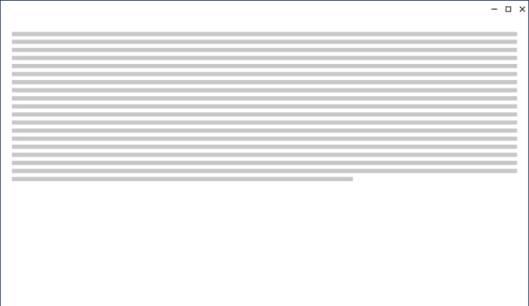
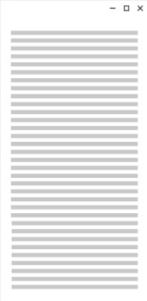
Resize
Augment the reading experience on a larger screen by simply growing the content frame
Notes:
<StackPanel x:Name="rootLayout" Orientation="Vertical">
<TextBlock x:Name="dataTextBlock" TextWrapping="Wrap"/>
</StackPanel>

Slide 11
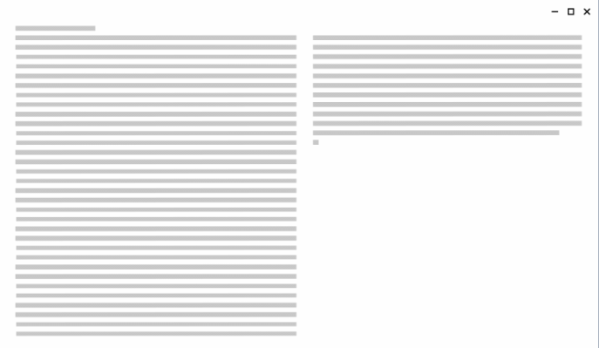
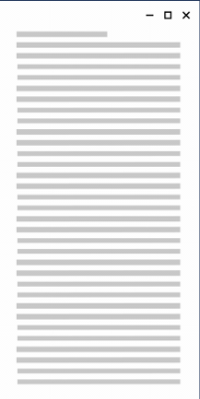
Reflow
Larger screen -> more columns, larger containers

Slide 12
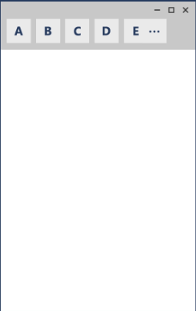
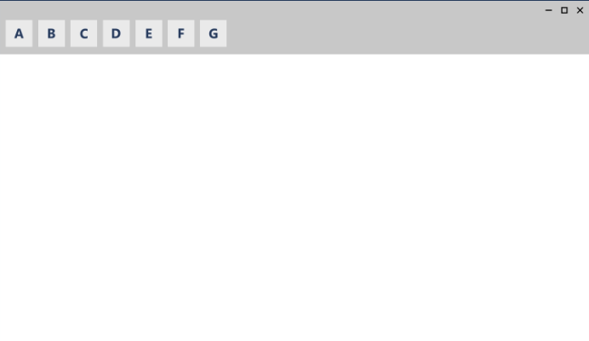
Show/Hide

Slide 13
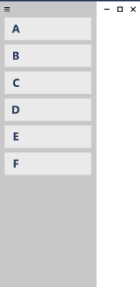
Replace
NavigationView: set pane to top or left

Slide 14
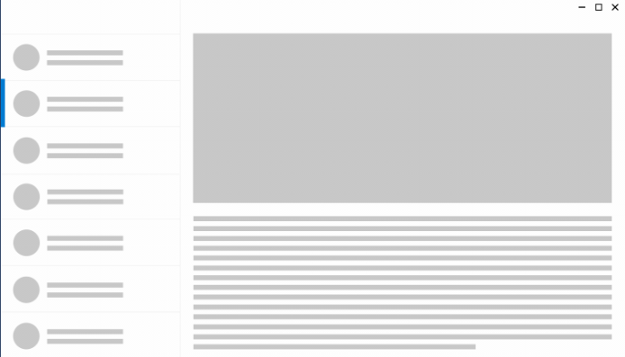
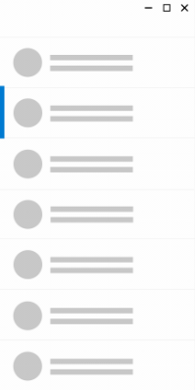
Re-architect
Expanding the window shows the entire list/details pattern

Slide 15
Layout panels
Layout panels for Windows apps - Windows apps | Microsoft Learn

Slide 16

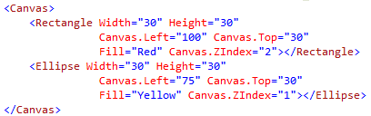

Canvas - Absolute positions
Index: Canvas.ZIndex. Bigger number on top
Attached properties
Quiz:

Slide 17
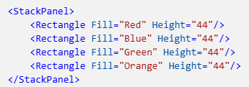

StackPanel
Notes:
<StackPanel>
<Rectangle Fill="Red" Height="44"/>
<Rectangle Fill="Blue" Height="44"/>
<Rectangle Fill="Green" Height="44"/>
<Rectangle Fill="Orange" Height="44"/>
</StackPanel>

Slide 18
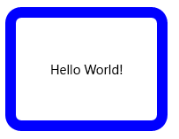
Panel border’s properties
RelativePanel, StackPanel, and Grid:
BorderThickness
BorderBrush
CornerRadius
Padding

Slide 19
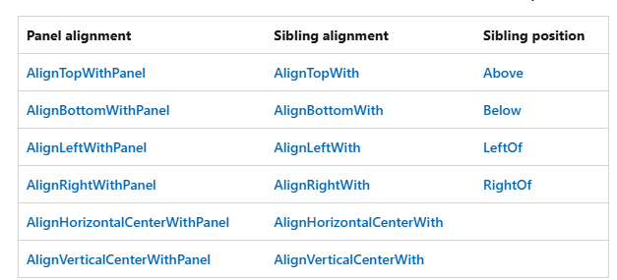
RelativePanel
To rearrange, use: VisualStateManager & AdaptiveTrigger

Slide 20
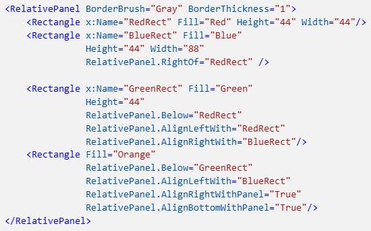
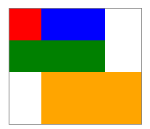
RelativePanel Example
Notes:
<RelativePanel BorderBrush="Gray" BorderThickness="1">
<Rectangle x:Name="RedRect" Fill="Red" Height="44" Width="44"/>
<Rectangle x:Name="BlueRect" Fill="Blue"
Height="44" Width="88"
RelativePanel.RightOf="RedRect" />
<Rectangle x:Name="GreenRect" Fill="Green"
Height="44"
RelativePanel.Below="RedRect"
RelativePanel.AlignLeftWith="RedRect"
RelativePanel.AlignRightWith="BlueRect"/>
<Rectangle Fill="Orange"
RelativePanel.Below="GreenRect"
RelativePanel.AlignLeftWith="BlueRect"
RelativePanel.AlignRightWithPanel="True"
RelativePanel.AlignBottomWithPanel="True"/>
</RelativePanel>

Slide 21
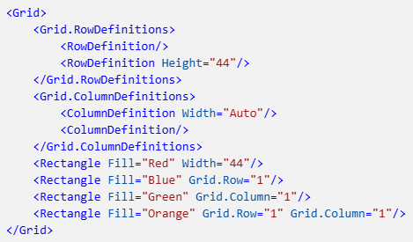

Grid => Table

Slide 22
Grid Sizing
Auto: UI elements resize to fit their content or parent container
*: proportional sizing

Slide 23
VariableSizedWrapGrid
Rows or columns automatically wrap to a new row or column when the MaximumRowsOrColumns value is reached.

Slide 24
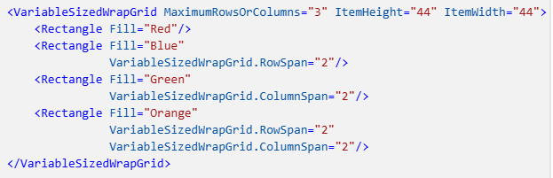

VariableSizedWrapGrid Example

Slide 25
Special-purpose panels
Only as an ItemsPanel to display items in an ItemsControl
ItemsStackPanel
ItemsWrapGrid
VirtualizingStackPanel
WrapGrid

Slide 26
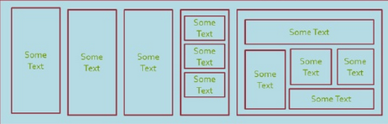
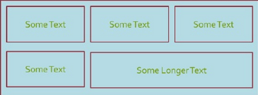
Inclass excersise
Write xaml code to create UI nearly like the image (80%)
Hint: there are a lot of solutions
100
300
1
400
100
200
200
2
400

Slide 27
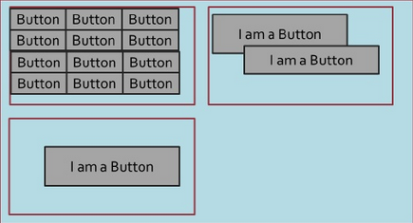
Exercises (cont)
60
200
30
3
300
100

Slide 28
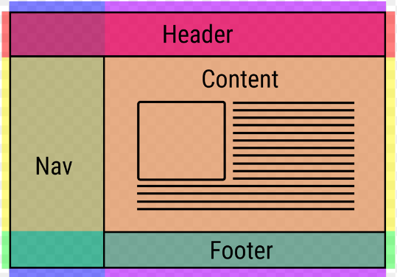
Inclass Exercise 4 - Classic layouts

Slide 29
Exercise - Responsive design
Settings

